Slide 1


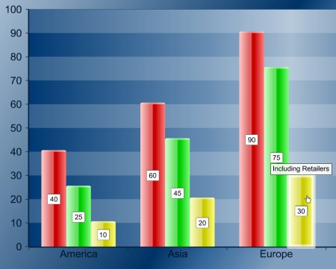
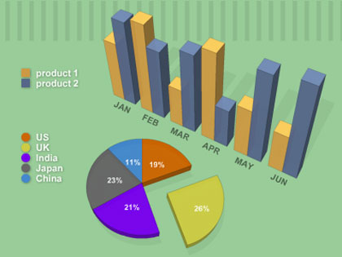
Poster Title Here Poster Title Here
Student Name, (Titles), University of Arizona College of Medicine, Phoenix
Mentor names, titles, institutions
Introduction
Results
 | Group 1 | Group 2 | Difference (95% CI or p-value)
number | 135 | 141
Age: mean ± SD | 37 ± 7 | 42 ± 6
Gender: M/F | 64/71 | 73/68
Ethnicity (if relevant)
Continuous Value 1: mean ± SD | 7.8 ± 2.2 | 8.3 ± 3.0 | -0.5 (95% CI -1.13 to 0.13)
Continuous Value 2: mean ± SD | 115 ± 22 | 128 ± 18 | -8.25 (95% CI -13.0 to -17.75)
Categorical Value 1 | 37/135 (27.4%) | 45/141 (31.9%) | -4.5% (95% CI -15.3 to 6.3%)
Categorical Value 2 | 88/135 (65.2%) | 111/141 (78.7%) | -13.5% (95% CI -24.0 to -3.0%)
Describe the number of subjects enrolled, number that completed data collection, and number analyzed. The results section describes research observations using narrative, tables, graphs and statistics in enough detail that readers can interpret them independently.
In the poster, Tables and Figures are much more prominent than text, since you will be at the poster to discuss findings with visitors. Include both negative and positive results. Results are often clearer if you subdivide results into logical segments with clear subheadings.
The statistical analysis should report both p-values and intensity of any differences noted; e.g., measures of effect such as Odds Ratios, Relative Risk, Correlation Coefficient or 95% Confidence Intervals.
This section should provide enough information to let a faculty member in a clinical or basic science department easily understand and review the project. The introduction is based on your background literature review which identified knowledge gaps. After reading this short introduction section, the project’s significance and rationale should be crystal clear to the reader.
Conclusion
This section provides a summary of the major findings of your project. It makes clear the originality, impact, strengths and weaknesses of the work.
Please feel free to contact the SP office for any advice or questions. We are happy to help.
Research Question
State your research question in clear and straightforward fashion. Use PICO format if appropriate (e.g., such an intervention or comparison study.) Your research question should target one or more of the knowledge gaps identified in your introduction. Specifically state the primary outcome and secondary outcomes.
Table 1: Include description caption. Use tables or graphs to display differences between groups. For tables, use column and row headings. For individual cells that report proportions or frequencies, state the ratio and percentages; e.g., “N/D (%)” instead of just percentages. Highlight cells that contain important findings.
Summary
Materials and Methods
Figure 1: All figures, charts, and tables should be numbered and include a descriptive caption. Use italics for the captions. Where appropriate, use a Patient Flow Diagram to report the numbers of patients in groups and subgroups
Summarize the results of your project in one to three bullet points.
This section describes what you did to answer your research question. Provide a description of the study design using standard terms; e.g., case series, case-control, cohort, clinical trial, quality improvement. Include anticipated number of subjects, location and dates of enrollment, the rationale for using this number of subjects (e.g., power analysis), the variables that will be collected/analyzed, and the analytic and statistical methods to be used. This section should also include other methodology; recruiting/enrolling subjects; specific methods, manipulations, or procedures.
Acknowledgements
Figure 3: Include descriptive caption. For graphs, label X- and Y- axis. Explain the meaning of symbols, such as lines (e.g., mean or median), boxes (e.g., IQR), brackets (e.g., SD or range), and data points (e.g., outliers).
I wish to thank my mentor Dr. Sally Smith and her collaborator Dr. Mary Jones. I would also like to thank Dr. Mike Sommers for contributing the antibodies.
Figure 2: Include descriptive caption. Use italics for the captions.
Notes:
DO NOT CHANGE POSTER SIZE: This template is set up for a poster that is 42” wide x 36” tall, to fit on the display panels. The header width is 8.87” and the height is .75” with 1-1/2” between each middle column and 1” on the left and right columns. The text boxes are 8.75” wide. Please do not use less that 30 pt font for any text or tables in the poster. The horizontal position of the first header is 6.25” from the top right corner.

